Slide 1

Sweet Karolines Cakes Analysis
BY: SILVER SOUL
BENJAMIN BENOIT, NICK GAY, MATT HOLSTON, ALEX MATTINGLY, ADAM SCHWEITZER, AND NICK TAYLOR

Slide 2








Problems
Karoline would like to…
CREATE MORE CUSTOMER CONTACTS
STREAMLINE CUSTOMER INTERACTIONS
AUTOMATE HER BUSINESS TO INCREASE EFFICIENCY
INTEGRATE AN ONLINE ORDERING AND PAYMENT SYSTEM

Slide 3
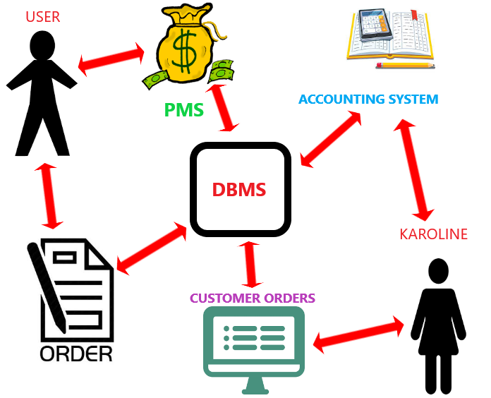
Process System
The diagram displayed above demonstrates the interactions between Karoline, the system, and the customer. PMS = Payment Management System, DBMS = Database Management System.

Slide 4

Process System Components
Payment System: Paypal
Web Domain: GoDaddy
Antivirus Software: Avira
Accounting System: Quicken
Content Management System: ExpressionEngine
ExpressionEngine comes with a built in database and web-store, while also being easy to learn.
Notes:
Yeah don’t know if we should add a slide for the cms or not...

Slide 5
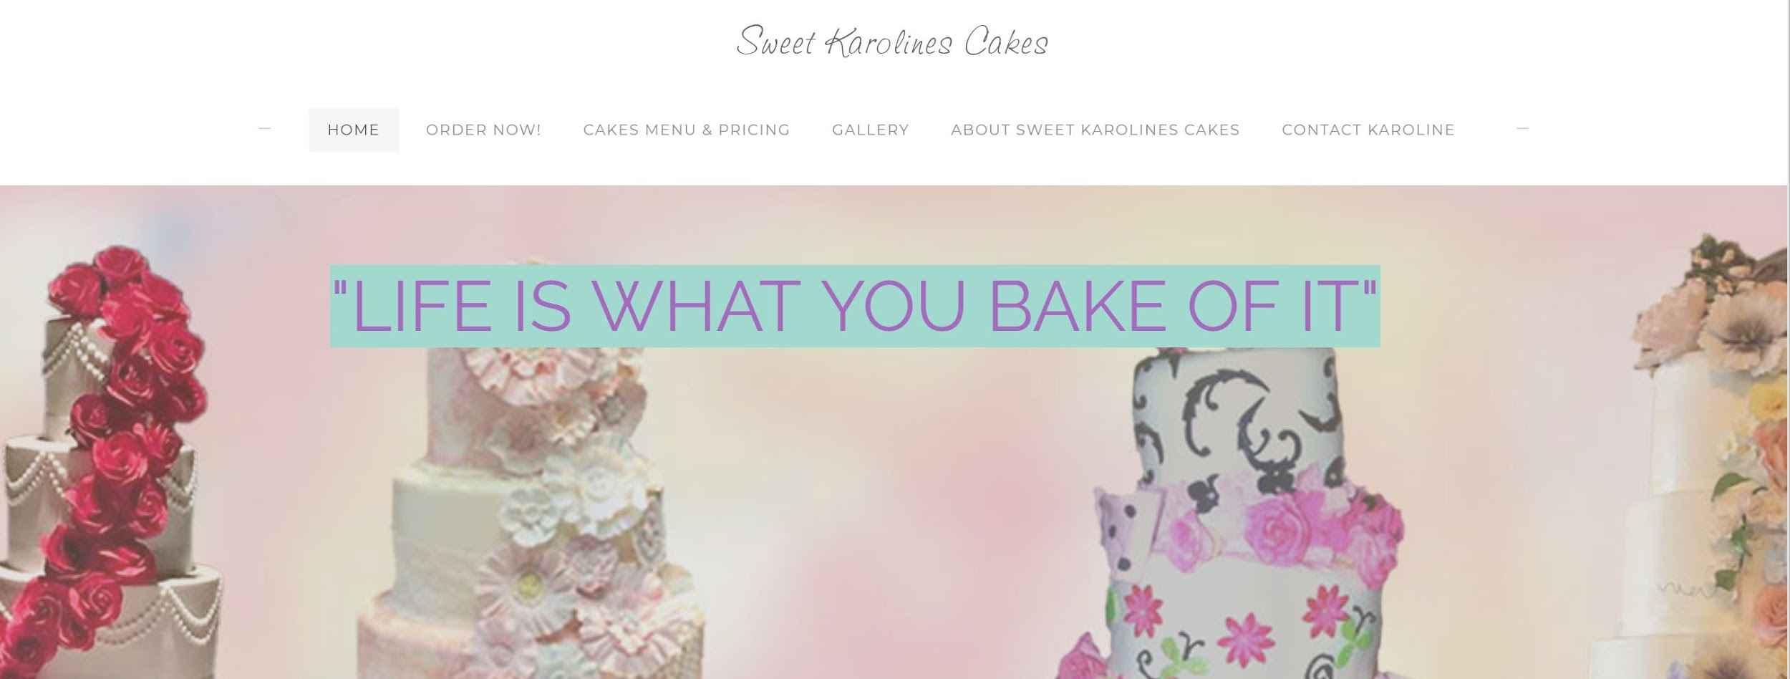
Prototype - Home Page
This image was created to give Sweet Karoline’s an idea of what the homepage of the website may look like. It includes tabs for the home page, order form, the menu, a gallery for photos of products, an about page, and the contact page.

Slide 6
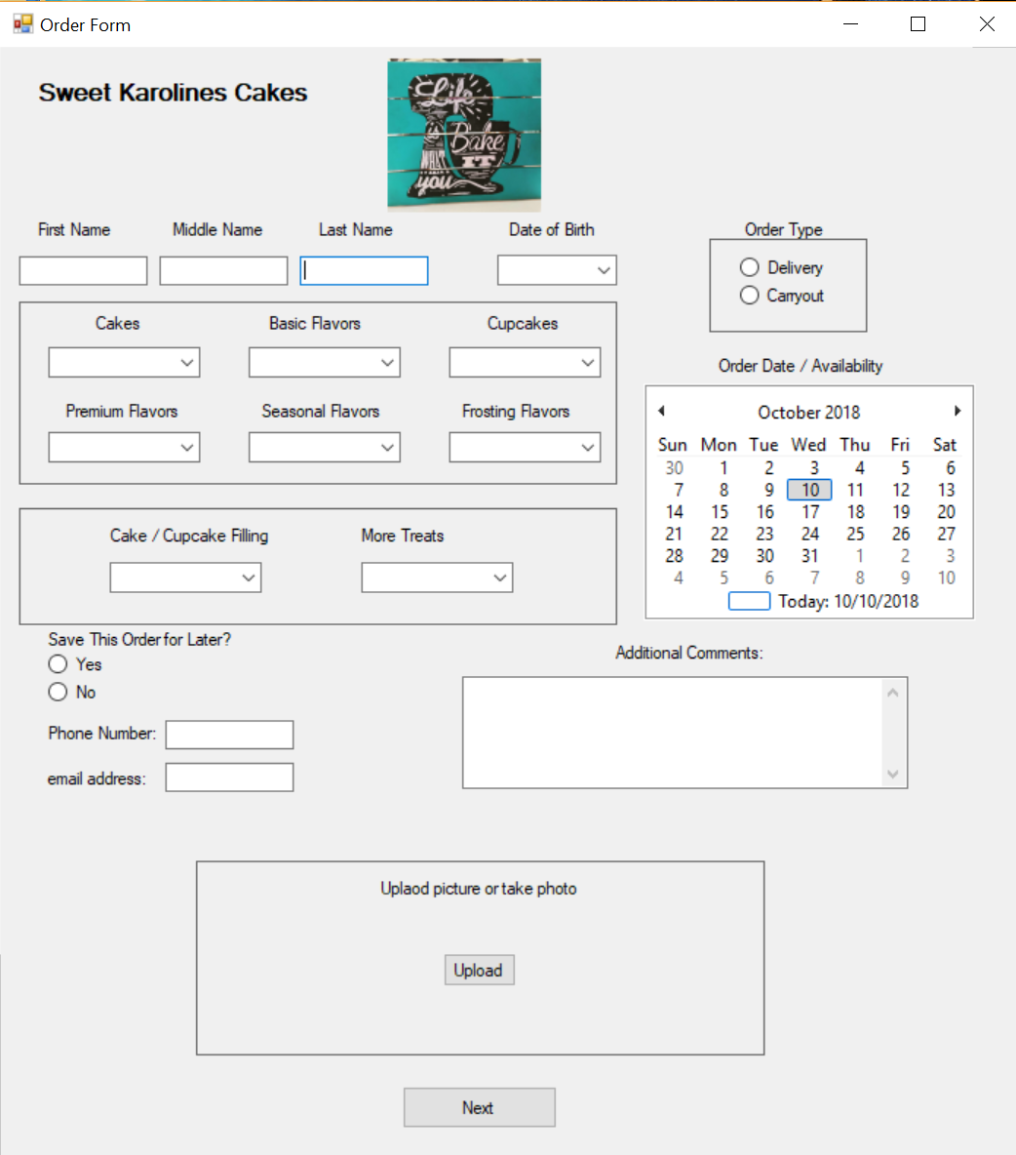
Prototype - Order Form
This is a basic prototype of what the order form will look like when the website is completed. It contains many fields that need to be filled with customer information. There is also a text box for any additional information, a calendar that lists available order dates, and the form gives the customer an option to upload a photo to give Karoline a better idea of what they want. Despite aesthetics, however, the main purpose of this form is to allow the customer to make an order, and it is designed in a way to make this an easy process.

Slide 7
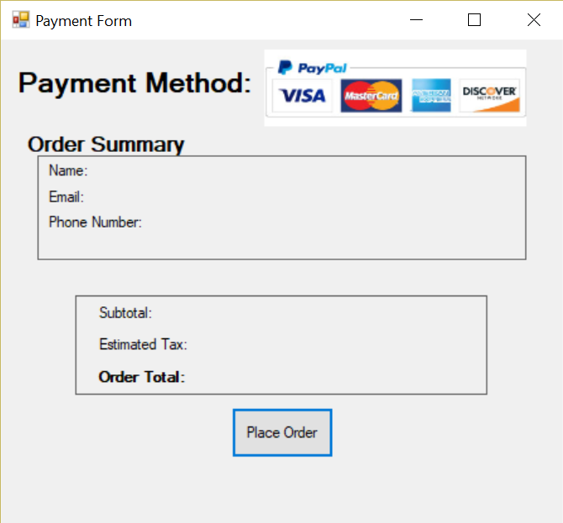
Prototype - Payment Form
This is a basic prototype of what the payment form will look like when the website is completed. Paypal will be the sole method of payment that is accepted, so it is displayed at the top of the form. The symbols for the various credit card companies signify that they are all processed through paypal. Since it can be a liability, Sweet Karoline’s website will not handle credit card information directly. The rest of the form consists of an order summary that displays the type of product that was ordered and the total cost

Slide 8
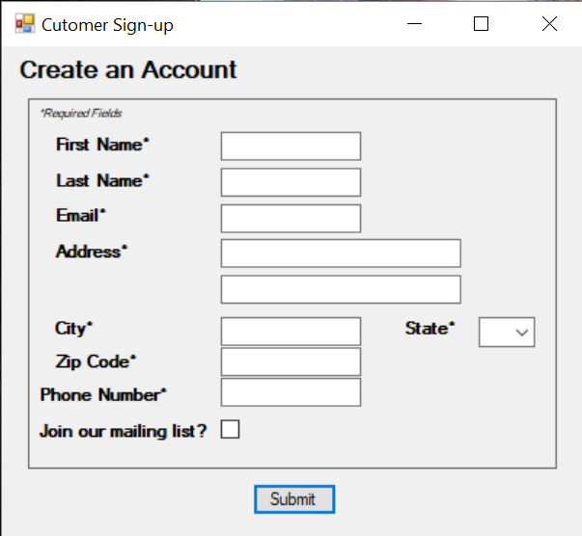
Prototype - Account Setup
This is a basic prototype of what the account creation form will look like when the website is completed. Nearly all of the fields require the customer to enter their information to create an account with Sweet Karoline’s Cakes. The form also includes an option to join a mailing list.

Slide 9
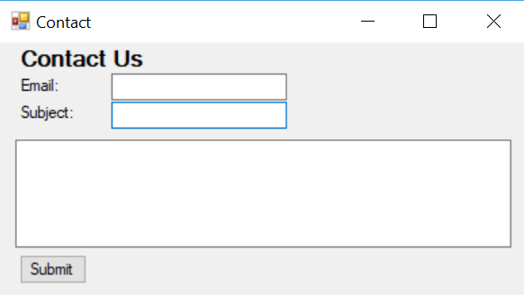
Prototype - Contact Form
This is a basic prototype of what the contact form will look like when the website is completed. The customer will enter their email, add a subject, and compose their message. The contact form will forward all messages to the administrative email.

Slide 10
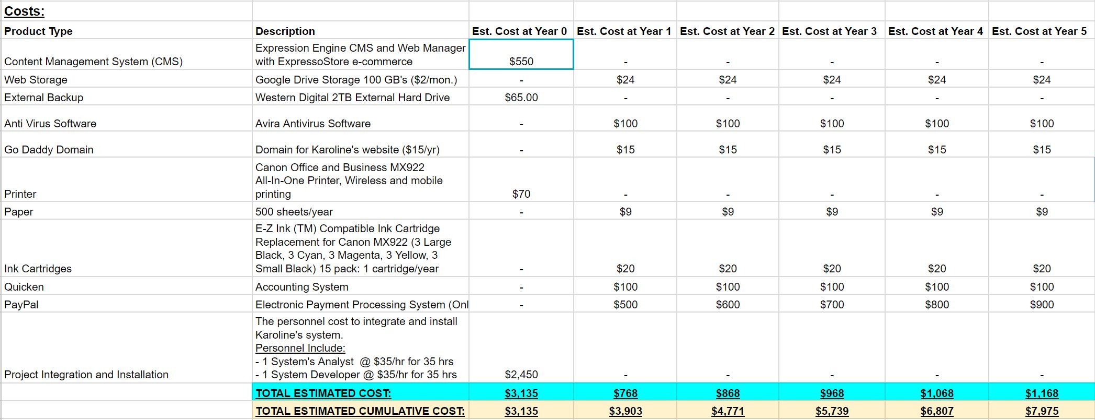
Feasibility Analysis - Costs

Slide 11
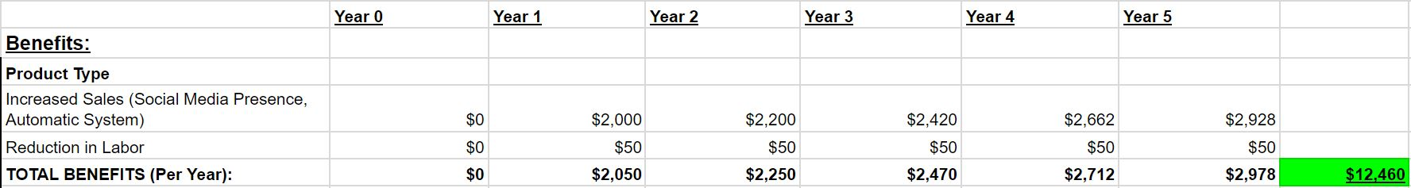
Feasibility Analysis - Benefits
Notes:
INCREASED SALES HAS A 10% INCREASE EACH YEAR AFTER YEAR 1

Slide 12
Important Numbers:
Return on Investment: 36%
Break Even: Between Years 2-3
Net Present Value: $3,846

Slide 13

Questions?

